Slide 1




Astronomy 1010 chapter 6
Clayton State University
Slides for Astronomy textbook from OpenStax
https://openstax.org/books/astronomy/

Slide 2
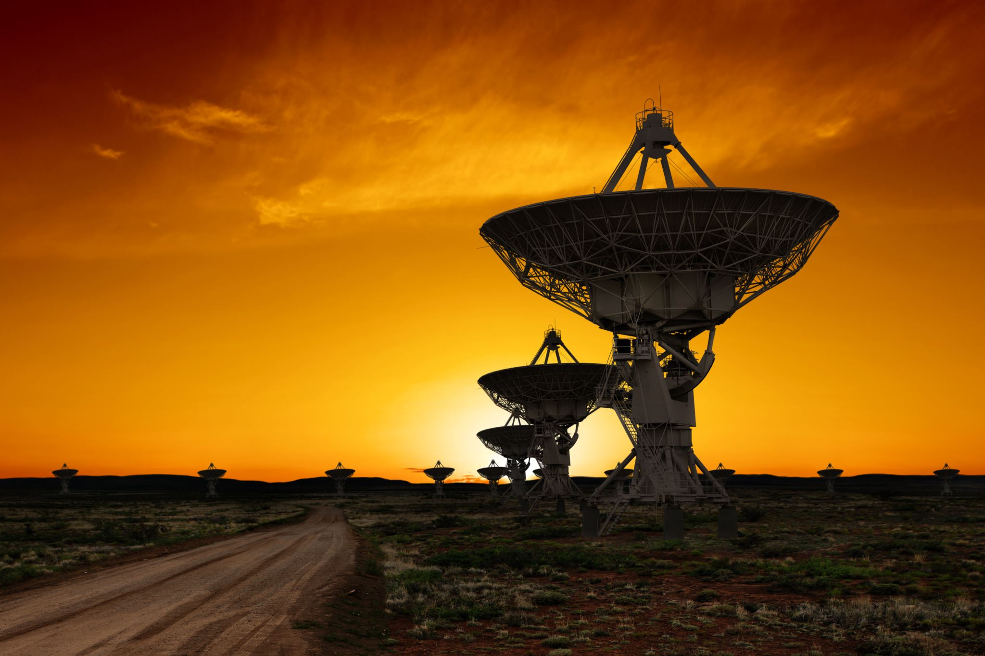
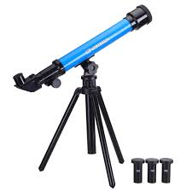
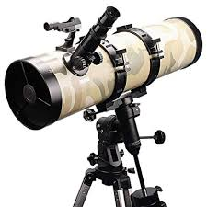
Basic optics and telescopes
There are many types of telescopes:
  Radio
  X-ray
  Infrared
  gamma-ray
  even gravity waves!
But they all use the same principle even though their looks and immediate design are based on the physics of their target information carrier (e.g., light)
In this class we will overview basic optics principles and the construction of the two telescope types that are used for the visible light – reflector and refractor.

Slide 3

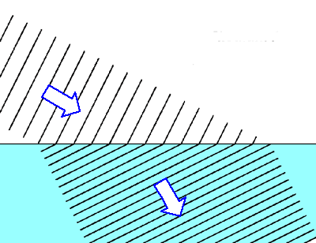
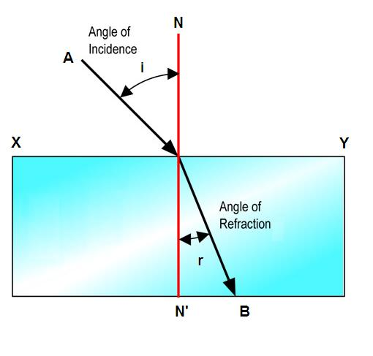
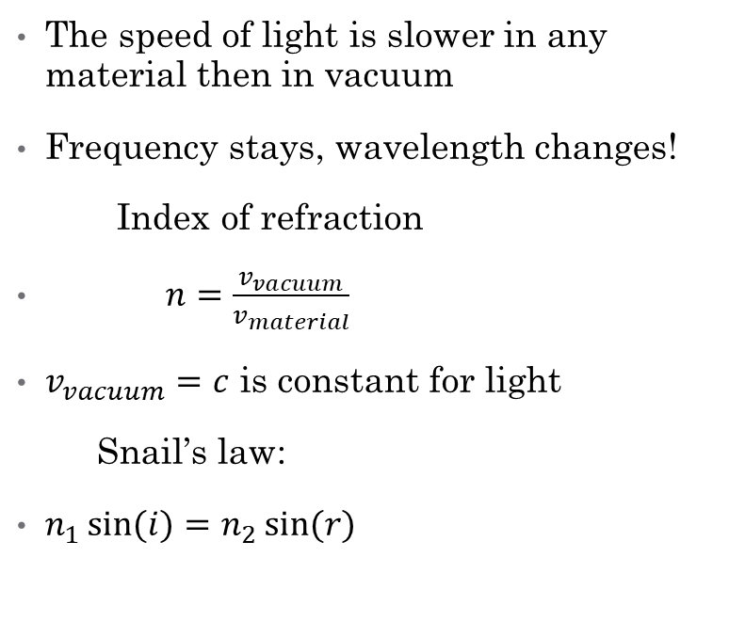
What is refraction?
The speed of light is slower in any material then in vacuum
Frequency stays, wavelength changes!
Index of refraction
$n=\frac{v_{vacuum}}{v_{material}}$
$v_{vacuum}=c$ is constant for light
Snail’s law:
$n_{1}\sin{(i)}=n_{2}\sin{(r)}$

Slide 4
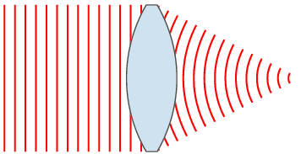
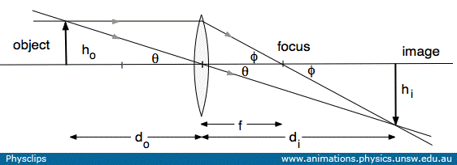
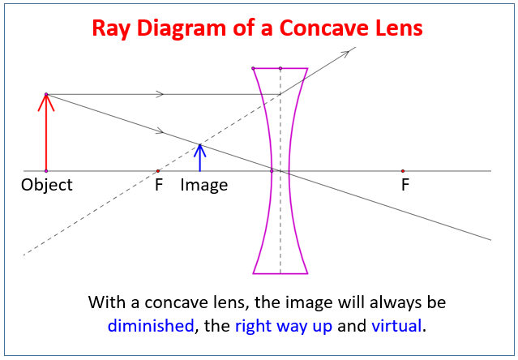
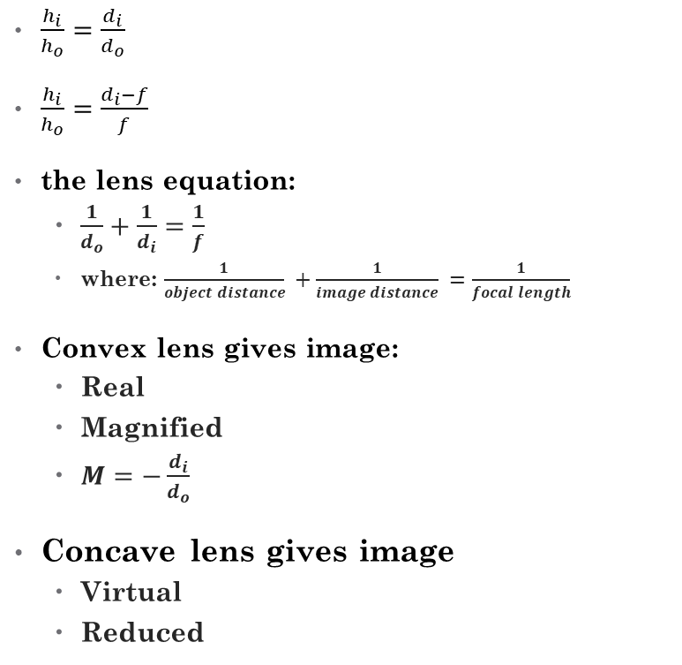
Lenses: convex and concave
$\frac{h_{i}}{h_{o}}=\frac{d_{i}}{d_{o}}$
$\frac{h_{i}}{h_{o}}=\frac{d_{i}−f}{f}$
the lens equation:
  $\frac{1}{d_{o}}+\frac{1}{d_{i}}=\frac{1}{f}$
  where: $\frac{1}{object distance} +\frac{1}{image distance} =\frac{1}{focal length}$
Convex lens gives image:
  Real
  Magnified
  $M=−\frac{d_{i}}{d_{o}}$
Concave lens gives image
  Virtual
  Reduced

Slide 5
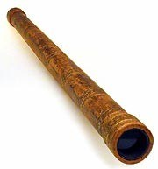
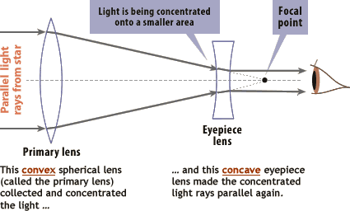
Galilean telescope
Our eyes are designed to ‘see’ the incoming light rays that are parallel
A lens can collect light, but it creates ‘image’, makes light rays intersect
Can used 2 lenses to ‘condense’ light
Telescope inverts image. Increases brightness. But its not a microscope, it doesn’t magnify
Need to add an eyepiece for that – on another slide.

Slide 6
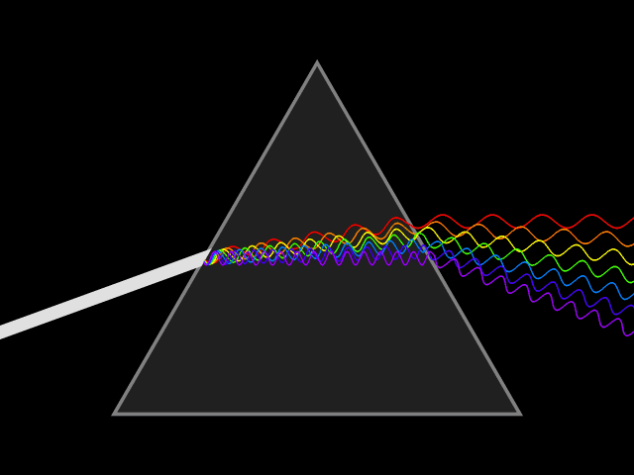
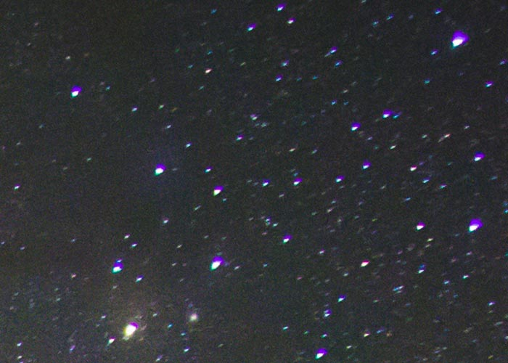
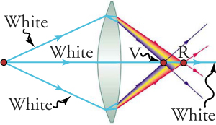
Chromatic aberrations
Different colors have different wavelength
Diffract at different angles
This causes chromatic aberrations

Slide 7
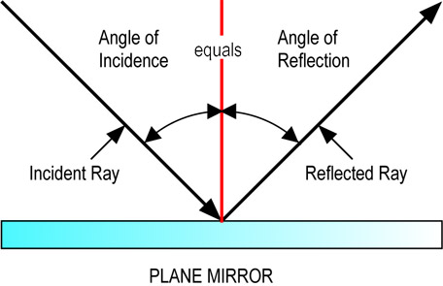
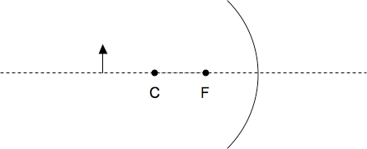
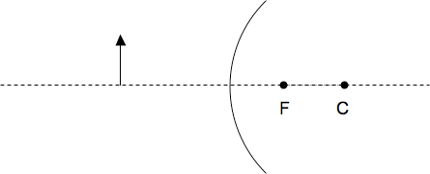
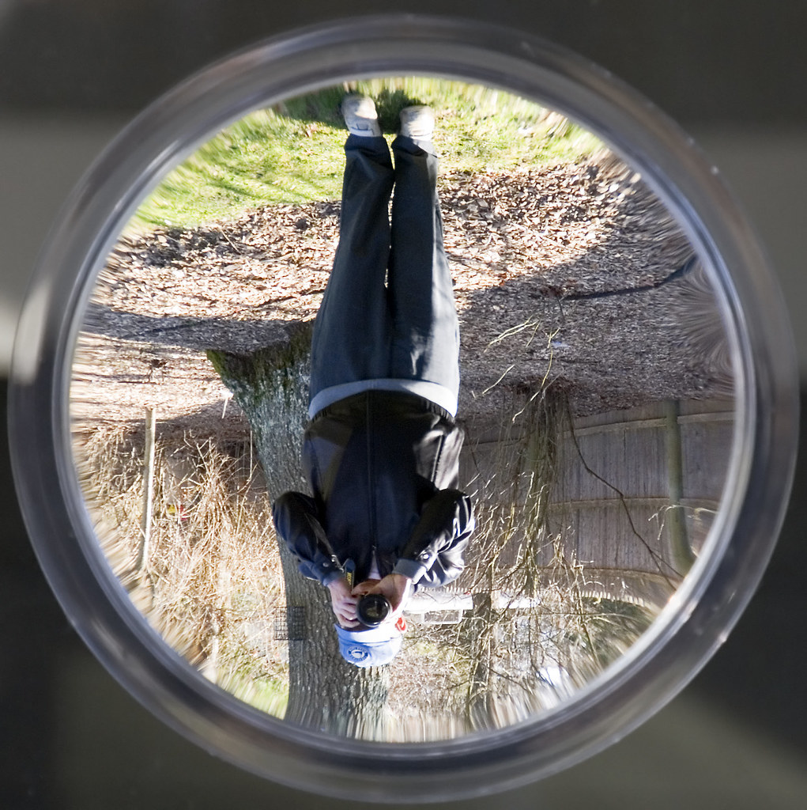
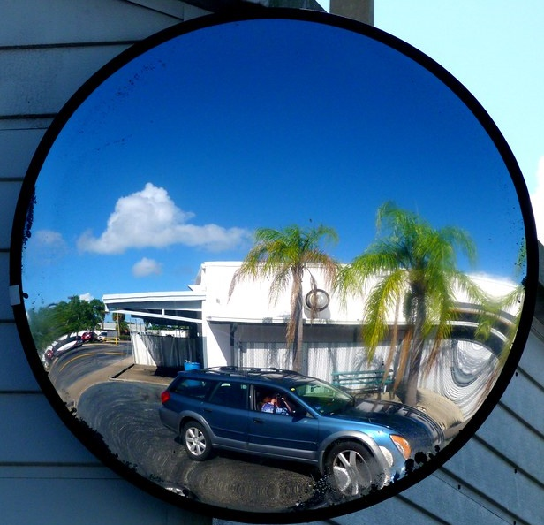
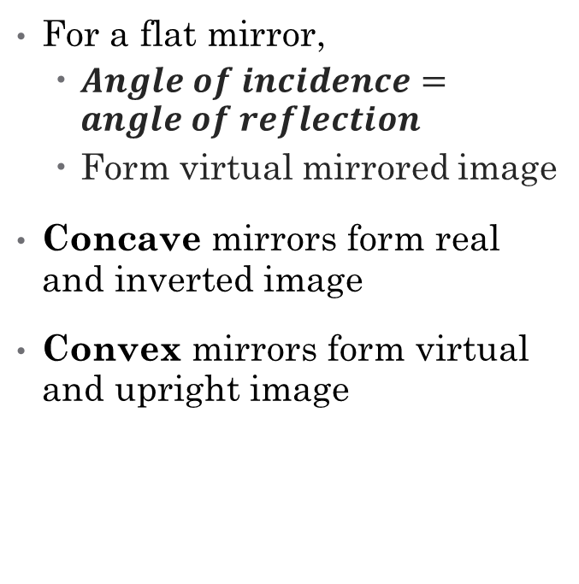

Reflections
For a flat mirror,
  $Angle of incidence=angle of reflection$
  Form virtual mirrored image
Concave mirrors form real and inverted image
Convex mirrors form virtual and upright image
Convex mirror
Image is:
Real
Inverted
Smaller
Concave mirror
Parallel
Parallel
Focal
Focal
Image is:
Virtual
Upright
Smaller
Image
Image
Perpendicular
$\frac{1}{d_{o}}+\frac{1}{d_{i}}=\frac{1}{f}$ and $M=−\frac{d_{i}}{d_{o}}$

Slide 8
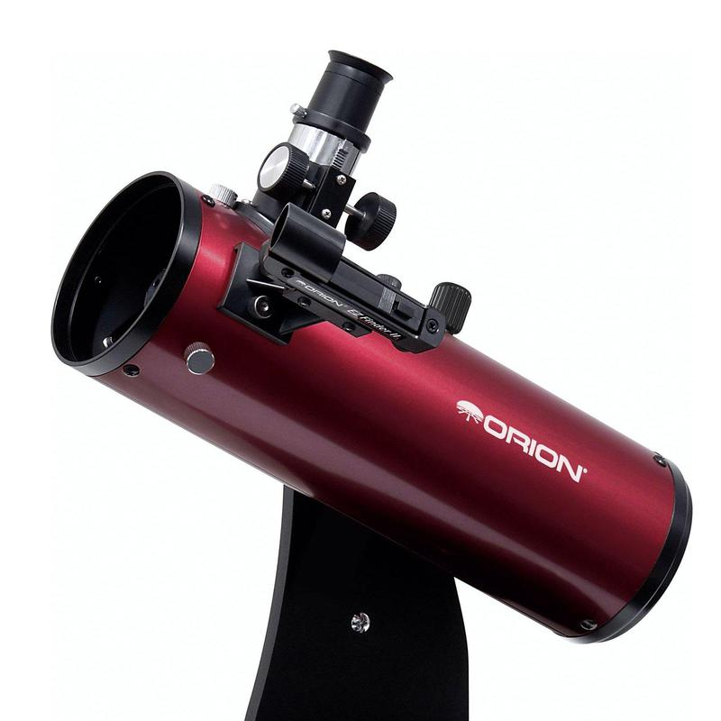
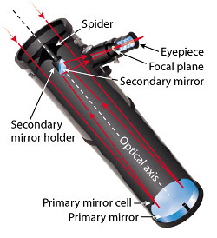
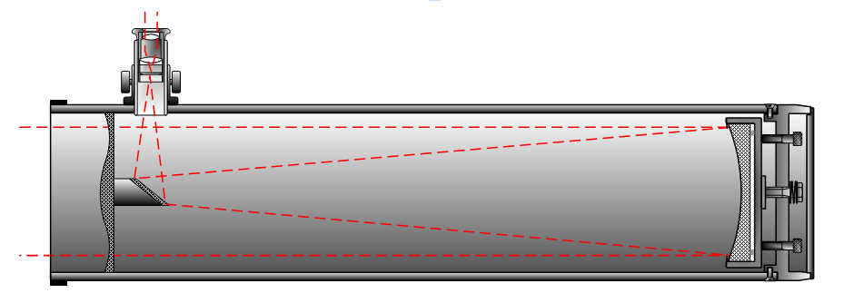
Newton’s telescope
One flat mirror and one concave
Concave mirror collects the light
Flat mirror redirects the light
Eyepiece forms magnified image

Slide 9
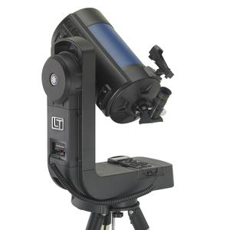
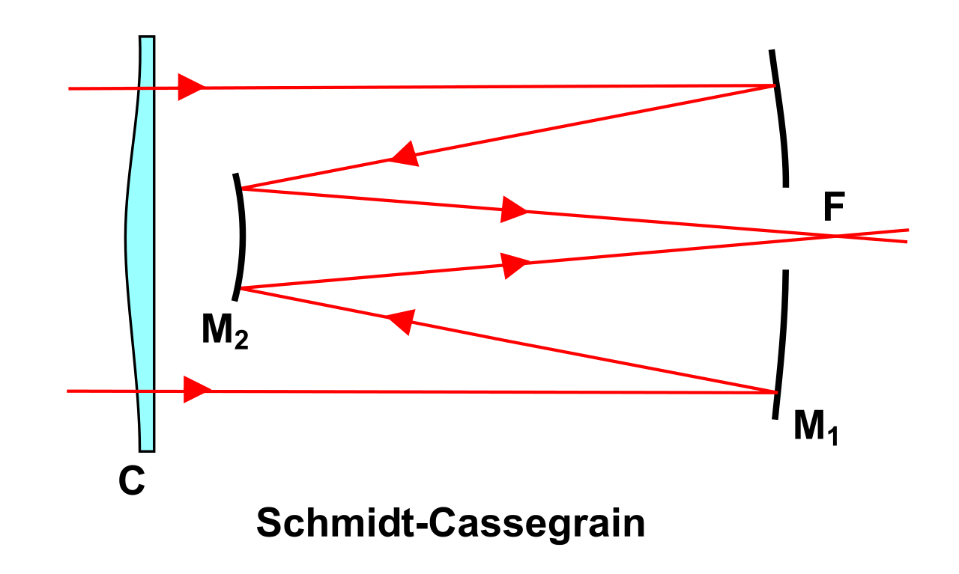
Schmidt – Cassegrain telescope
One concave mirror and one convex
A hole in main mirror in ‘shadow’ of secondary
Corrective plate
Viewed from behind
Smaller telescope size

Slide 10
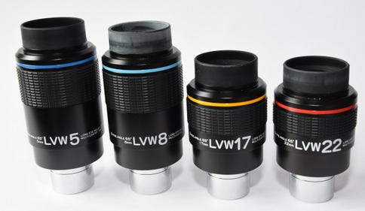
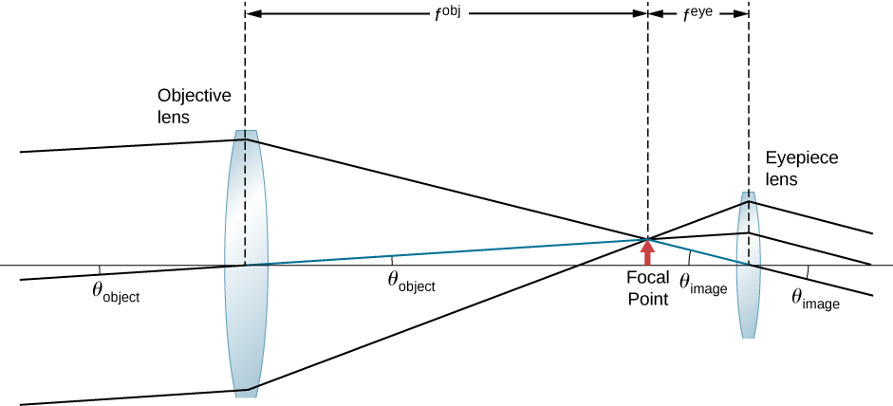
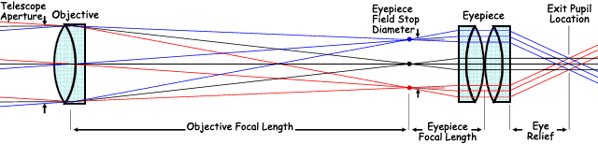
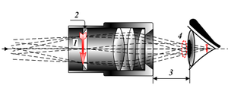
Eyepiece and magnification
The eye wants the parallel rays to see objects
There are special eyepieces to be used for camera attachment, to increase magnification (Barlow lens), to connect other instruments.
Typical magnification of a small telescope is x200-x600 or so

Slide 11
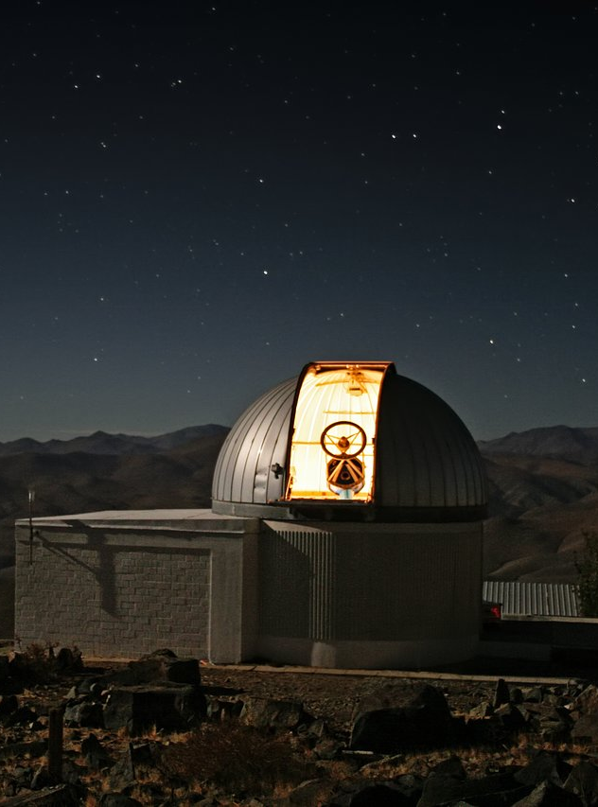
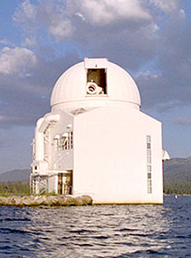
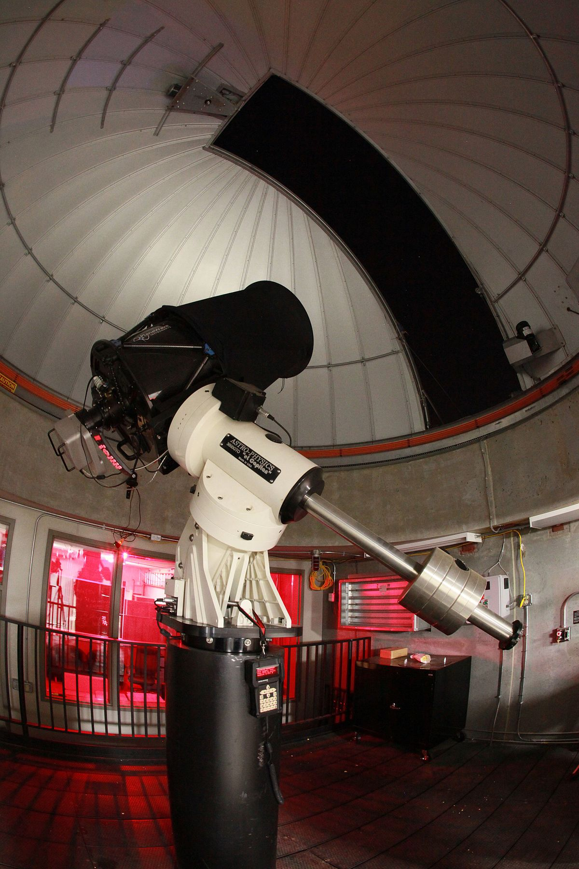
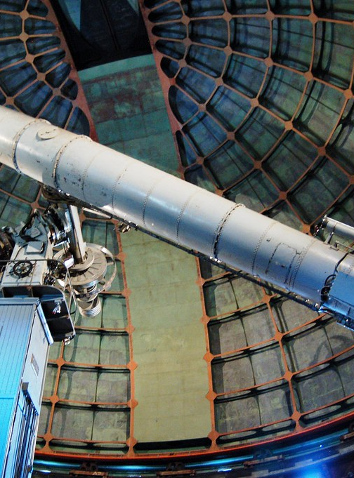
Observatory
Located in low light-polluted areas
Large stationary telescopes
Ability to attach instruments
Permanent support staff

Slide 12

Any Questions?

